Slide 1

Sk. Istiaq Arefin
112410323
Ratul Ghosh
112410038
Shihabun Shakib
112410073
Sumaiya Akther
112410318
United International University
Rushdania Bushra
112230039

Slide 2
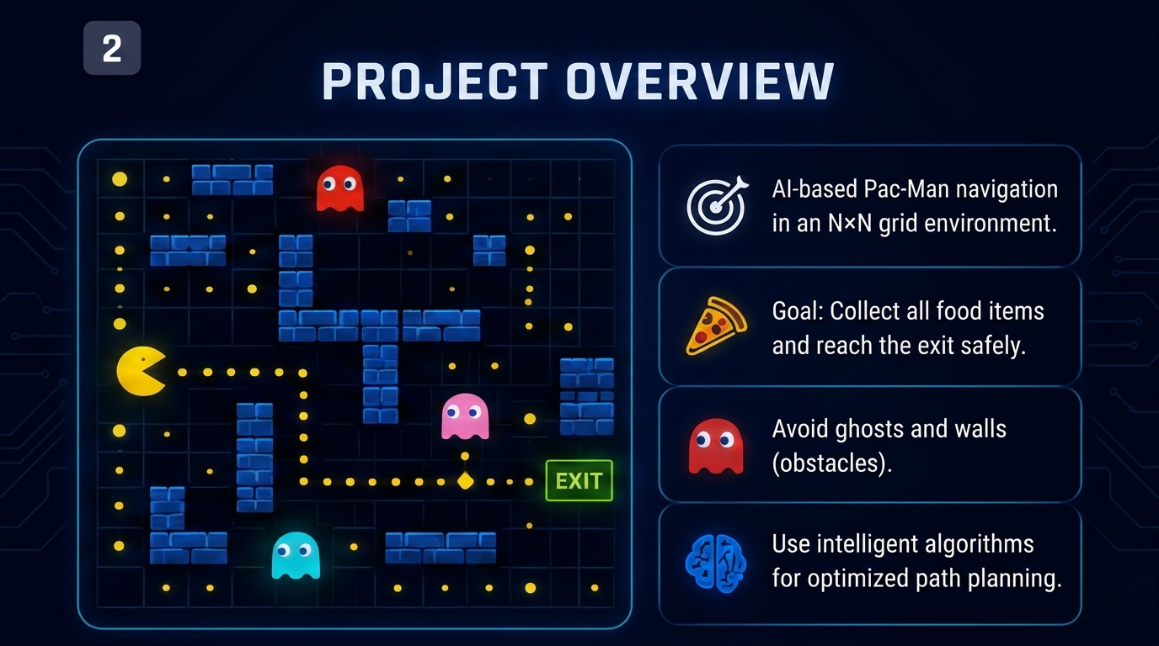

Slide 3
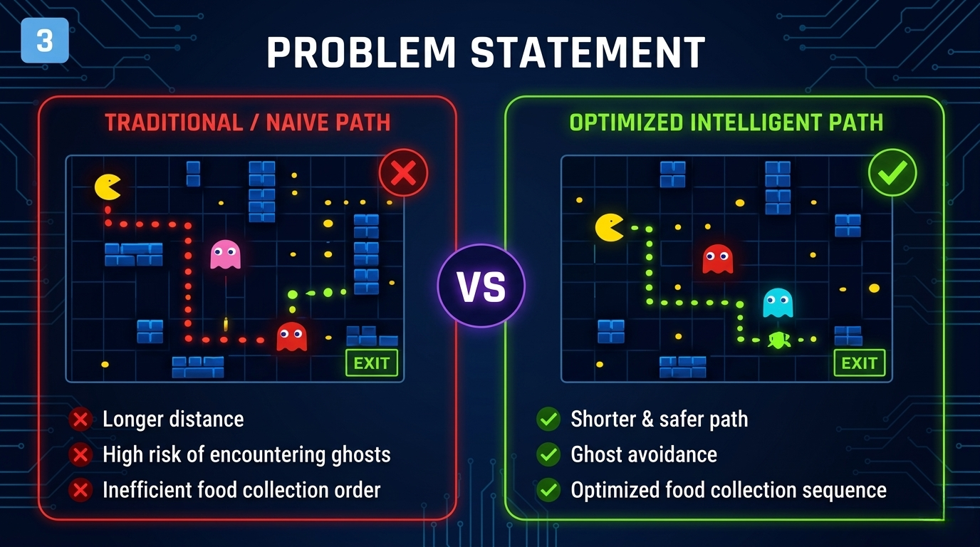

Slide 4
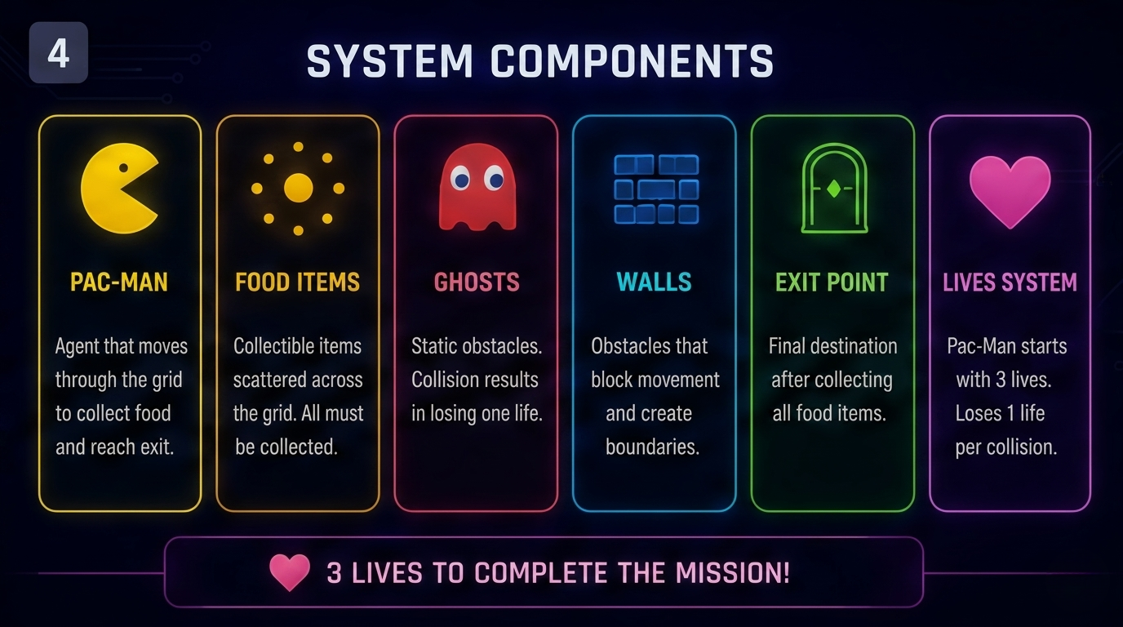

Slide 5
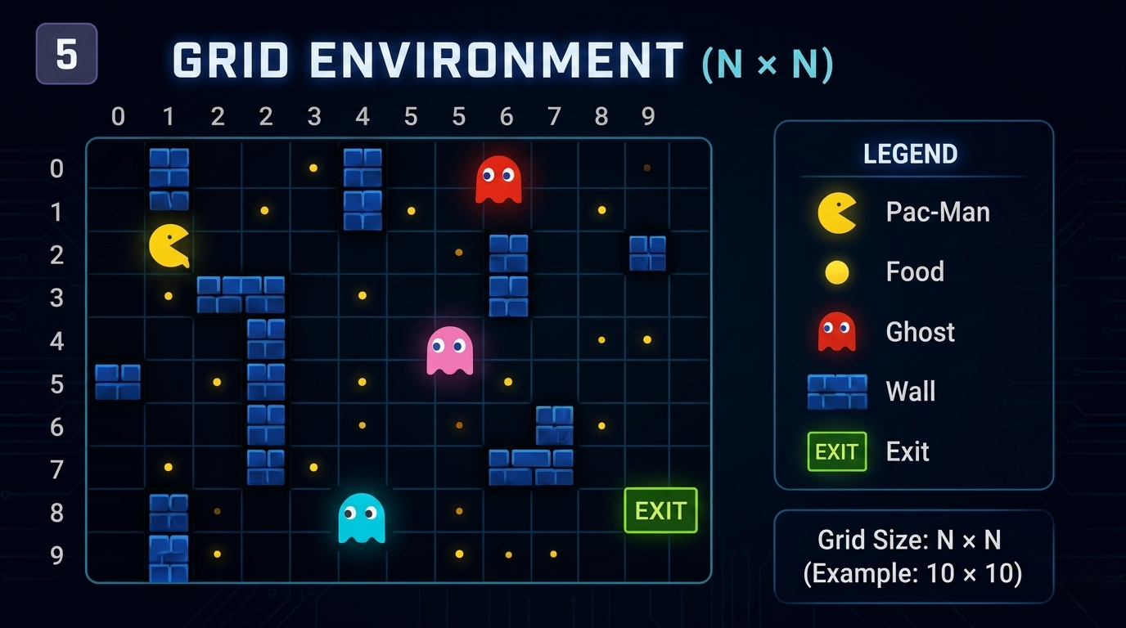

Slide 6
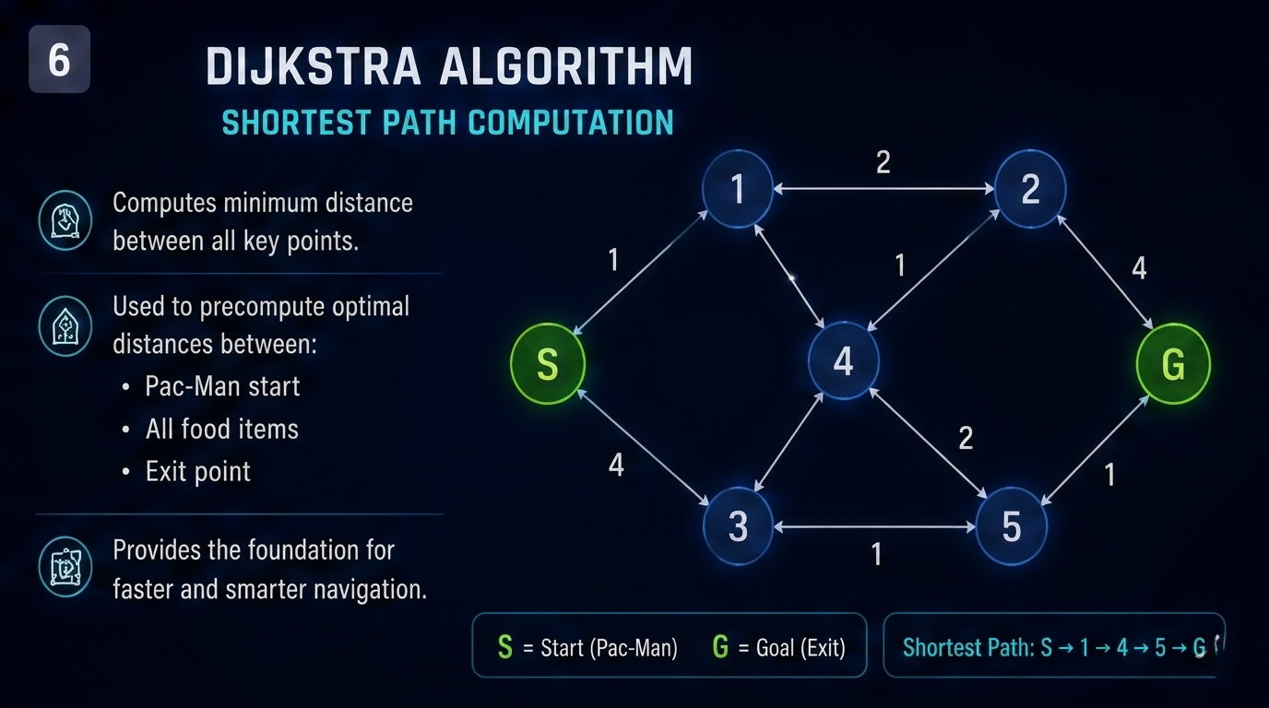

Slide 7
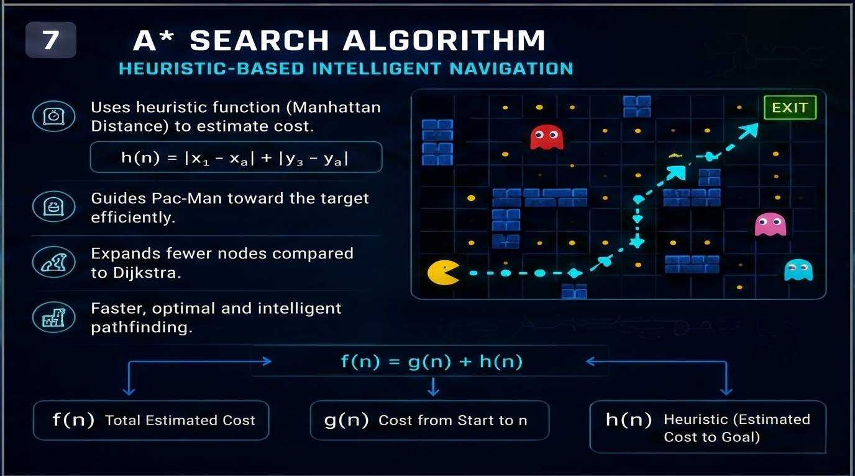

Slide 8
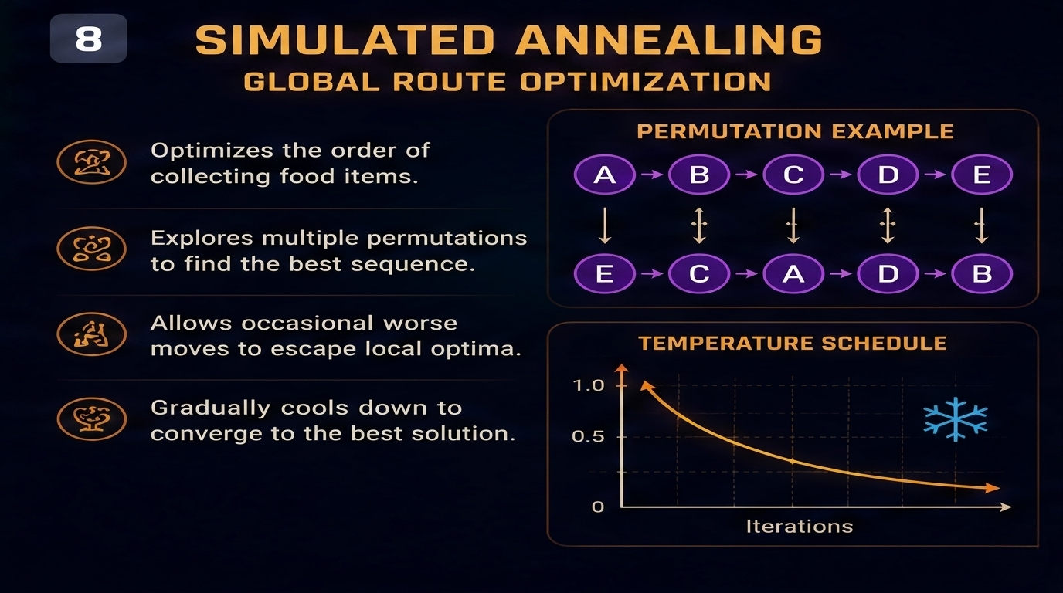

Slide 9
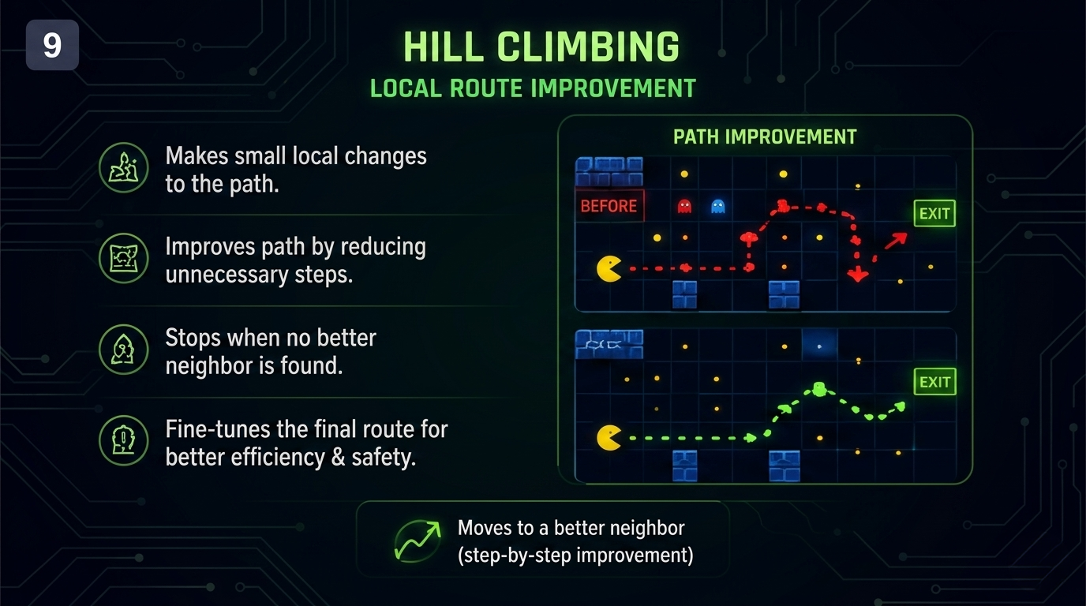

Slide 10
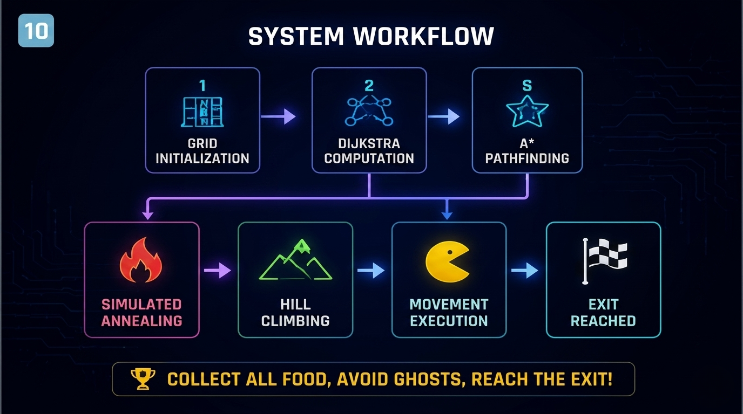

Slide 11


